Slide 1
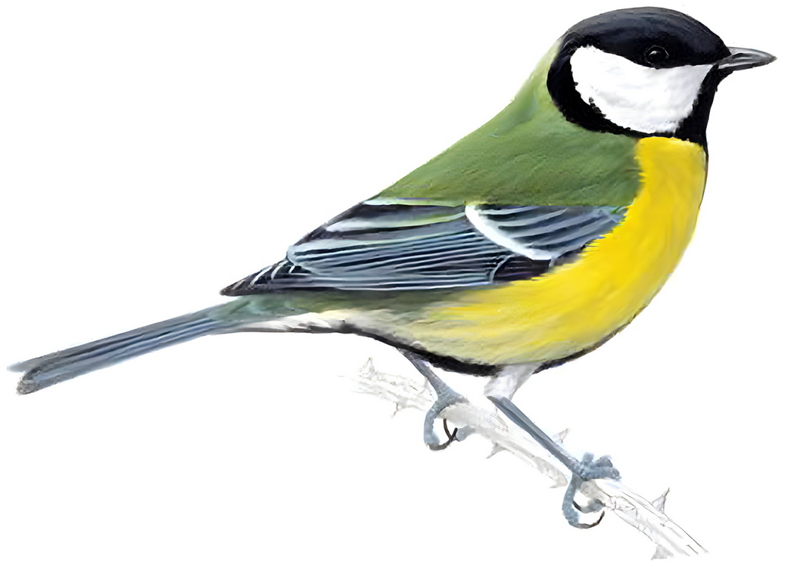
Anthropogenic effects on bird song in great tits
By: Bïrb (song)
[Tobias, Jude, Alfie, Chloe, Daniel, Evelyn and Lorena]
Photo from RSPB website

Slide 2
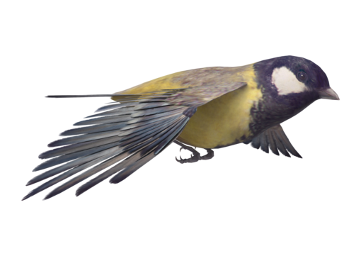

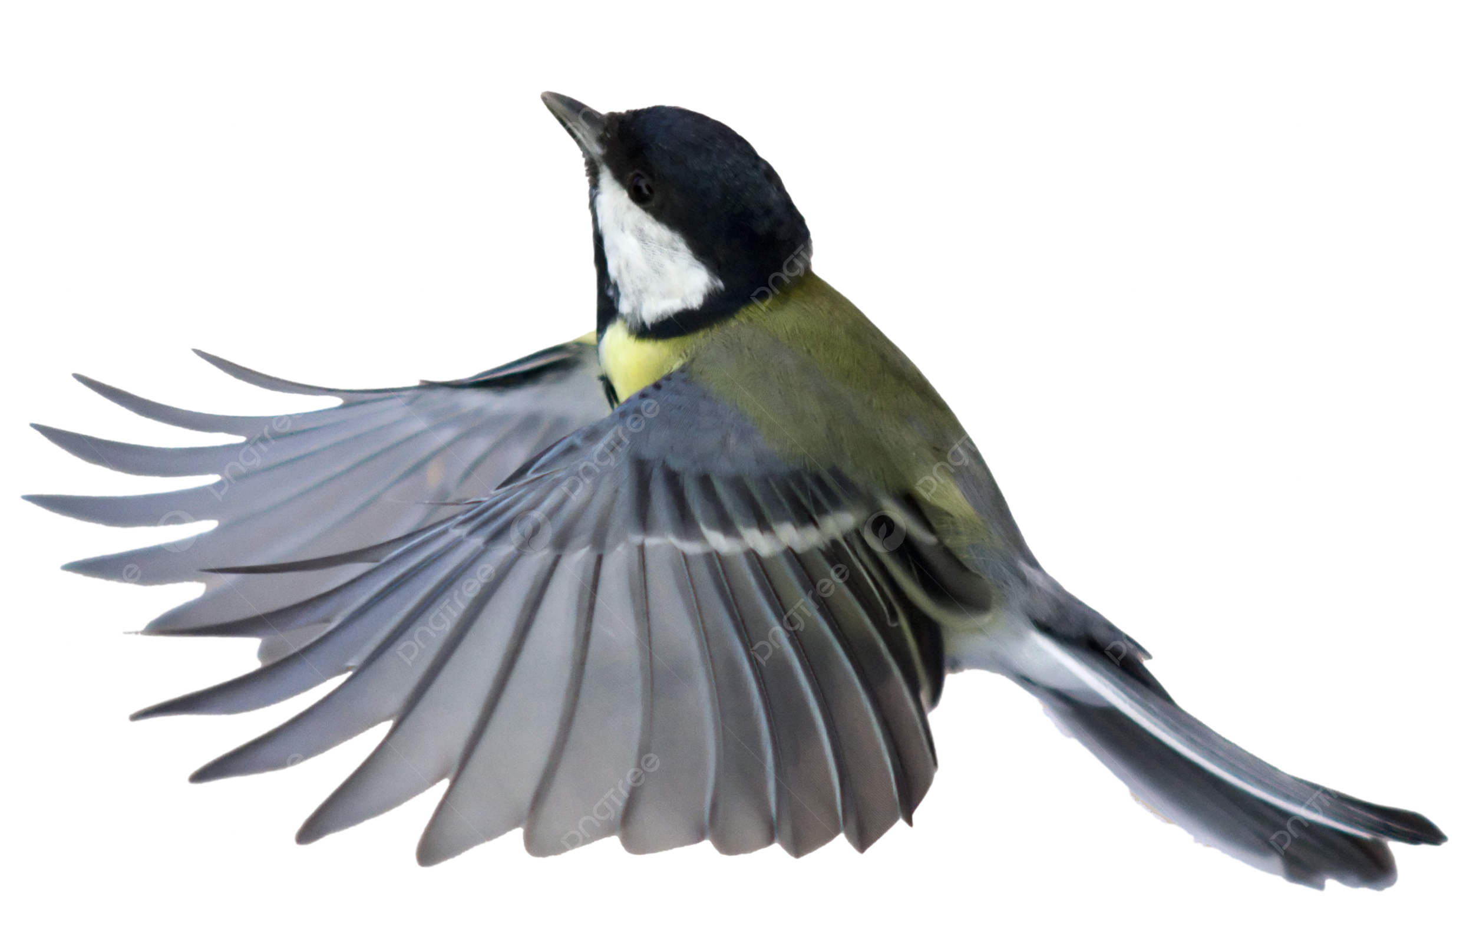

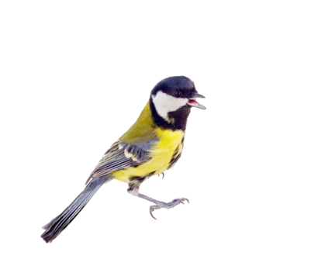


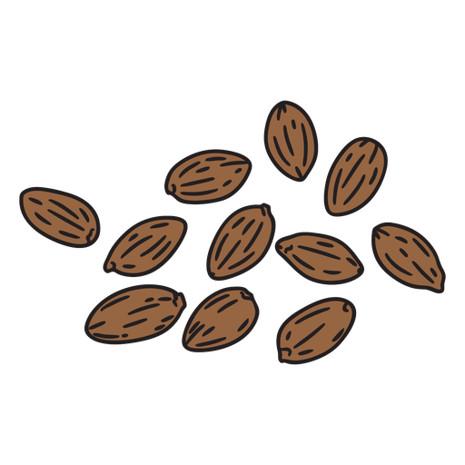
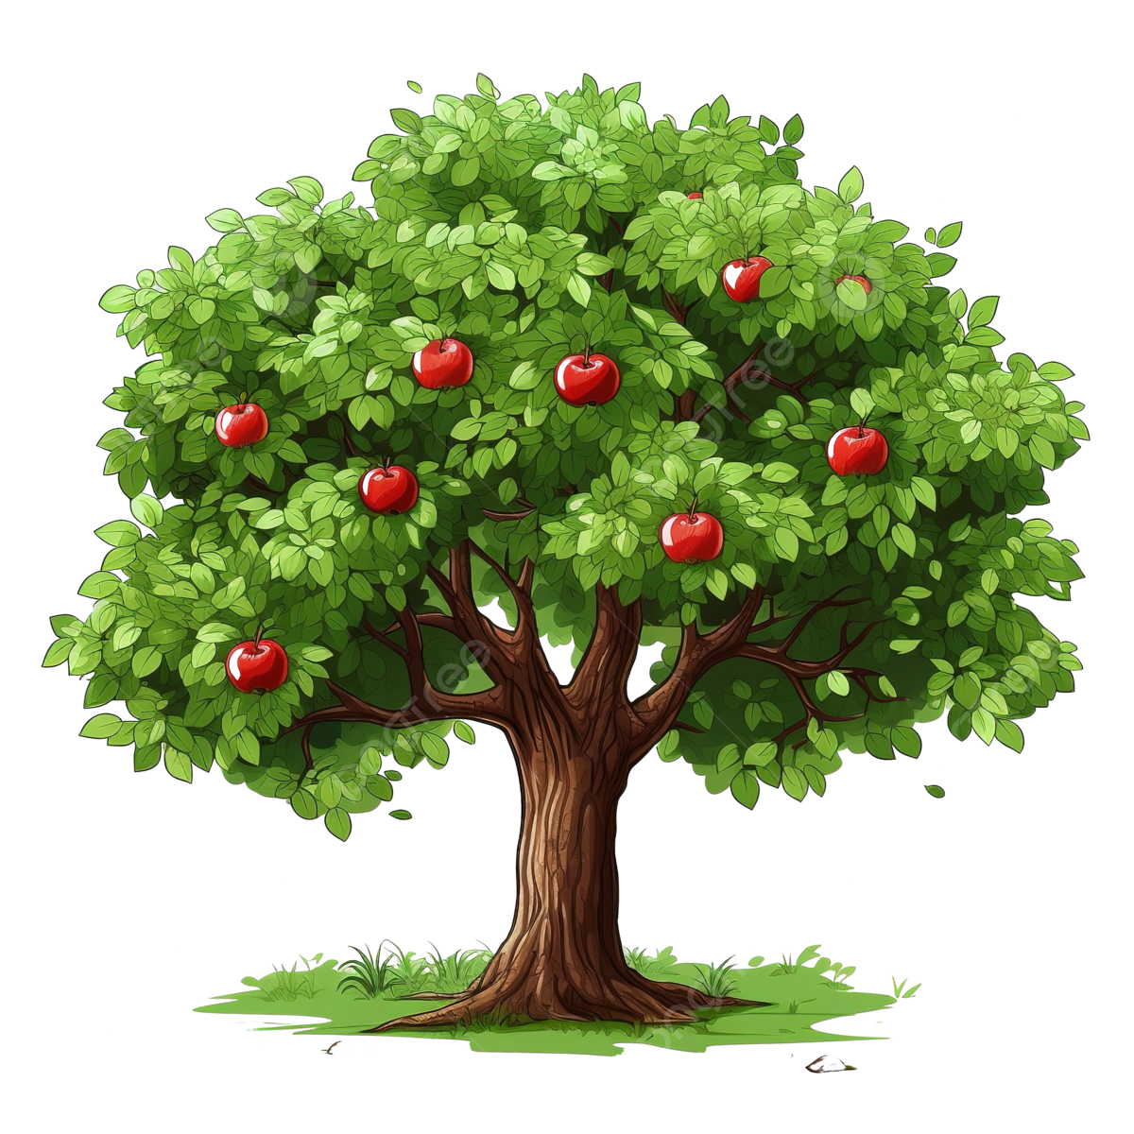
Blue Tits Importance
Diverse seed dispersal, main pest control in apple orchards (and others), an indicator and a keystone species (Corsini et al., 2017).
Extensive variation in calls, important in communication and signals. Key for survival (Rivera-Gutierrez et al., 2010).
Human interaction affects their development, constant stress in urban areas (Rivera-Gutierrez et al., 2010).
Globalization affects wildlife through climate change, disease, habitat loss, and pollution (Charmantier et al., 2015).
Images: https://pngtree.com/

Slide 3
Our hypothesis and past science we are building on (Introduction)
A model species
Wytham Tit Project
Resident / territorial / cope well with monitoring
Defining urban vs rural
- Rural: <3 medium sized buildings/ major roads within a 1 km distance from the chosen site, >70 decibels of noise
- Urban: more than 3 medium sized buildings and roads, large amount of human foot traffic, <40 decibels of noise
Our hypothesis: The constant low frequency urban noise causes pitch of song in great tits to increase accordingly
Studies we are building on: A long-term study of the great tit (Lack, D., 1964. ) & Birds and anthropogenic noise: are urban songs adaptive? (Nemeth, E. and Brumm, H., 2010.)

Slide 4
Methods 1 - setup
Integrate map. Maybe make the table one of areas of highest density, it would be hard, but fun and fucking metal. Choropleth?
Interactive elements
Choosing a location:
Ebird API map
Major cities / forests
Random sampling
Repeats
Buying equipment:
Trail cams, speakers and high quality microphones

Slide 5
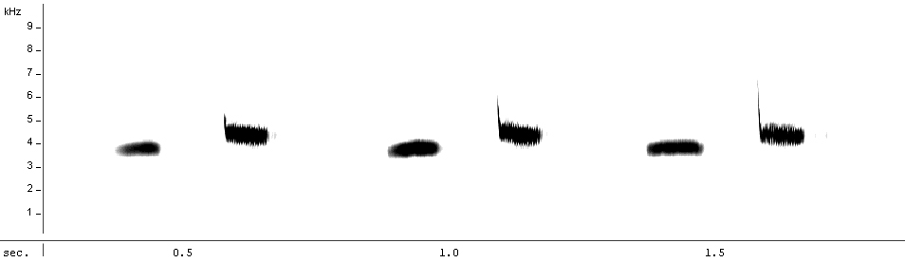

Methods 2 – Experimental Design
One main experiment with two control groups
Speakers and recorders in woods
City observations
Forest observations
Manipulative and observational
Repeats
- small experiment must be conducted prior to determine if calls return to natural patterns when urban noise is removed
Multiple sites across UK
Over 70 calls: tee-cher…tee-cher…
Sonogram
(Recording of the call)

Slide 6
Methods 3 – Statistical Analysis
Using R to construct tables and graphs from the data
The output of the recorders is a “spectrogram”
Taking the average of each group and measuring highest – lowest, not just peak
https://hansenjohnson.org/post/spectrograms-in-r/
https://stackoverflow.com/questions/47070327/r-boxplot-how-to-normalize-against-given-high-and-low-limits-instead-of-min-an
Use dummy data to make a spectrogram https://dosits.org/
https://www.izotope.com/en/learn/understanding-spectrograms.html

Slide 7
Limitations
No catch and release means we cannot weigh birds (Jarman. 2020).
Hard to estimate the distance a call is heard from [physics: wavelength decays and spreads out over distance, also have to account for blue / red shifting of sound if bird is moving]
Wildlife and Countryside Act 1981
Avoid disturbance in breeding season
Consent of landowners and may need a licence
Contents of urban noise playback

Slide 8
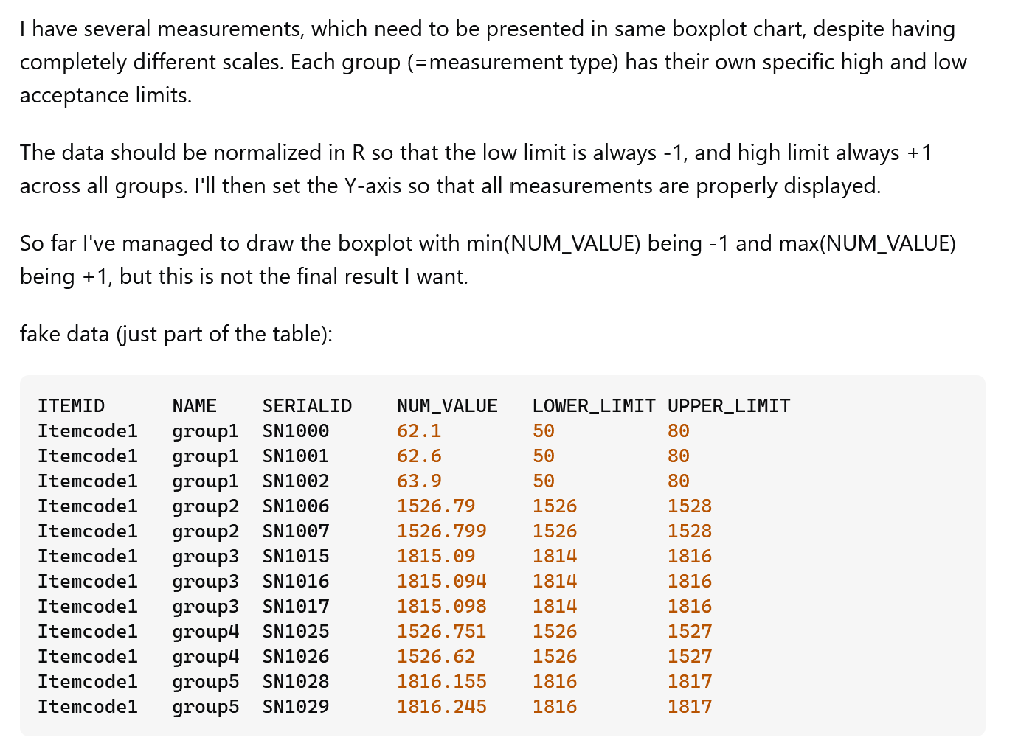
Results
Examples of these
Tables of the raw data
Boxplot with ANOVA[?]
Look at papers for plots tailored to this kind of work, shouldn’t be hard
The average frequency difference between low‐pitched forest and high‐pitched city songs was 205 Hz in great tits (Nemeth, E. and Brumm, H., 2010)
mean ± SD:
city = 3,517±115.8 Hz
forest = 3,312±90.9 Hz

Slide 9
Conclusion
Should our hypothesis be found correct, it implies that these birds can learn and adapt, others cannot so may be at risk from cities
We can also consider the speed at which the frequency of the calls adapts and changes which can show how quickly they can adapt their calls
Also that urban noise does impact pitch frequency in Great Tits and possibly other species
If the Great Tit calls do not revert from a changed frequency, this shows that Urbanisation may have a permanent effect on the calls of this species

Slide 10
References
Jarman, S. (2020) ‘Pitch of birdsong is determined by body size’, Physics World, 33(5), p. 6. Available at: https://doi.org/10.1088/2058-7058/33/5/9.
Lack, D., 1964. A long-term study of the great tit (Parus major). The Journal of Animal Ecology, pp.159-173. https://doi.org/10.2307/2437
Nemeth, E. and Brumm, H., 2010. Birds and anthropogenic noise: are urban songs adaptive?. The American Naturalist, 176(4), pp.465-475. https://doi.org/10.1086/656275
Legislation, 2024. Wildlife and Countryside Act 1981. Available at: https://www.legislation.gov.uk/ukpga/1981/69/contents#top (Accessed: 17 February 2025)
Rivera-Gutierrez, H.F., Pinxten, R. and Eens, M. (2010). Multiple signals for multiple messages: great tit, Parus major, song signals age and survival. Animal Behaviour, 80(3), pp.451–459. doi:https://doi.org/10.1016/j.anbehav.2010.06.002.
Corsini, M., Dubiec, A., Marrot, P. and Szulkin, M. (2017). Humans and Tits in the City: Quantifying the Effects of Human Presence on Great Tit and Blue Tit Reproductive Trait Variation. Frontiers in Ecology and Evolution, 5. doi:https://doi.org/10.3389/fevo.2017.00082.
Charmantier, A., Doutrelant, C., Dubuc-Messier, G., Fargevieille, A. and Szulkin, M. (2015). Mediterranean blue tits as a case study of local adaptation. Evolutionary Applications, 9(1), pp.135–152. doi:https://doi.org/10.1111/eva.12282.
‌Chantal, D. (2011) Parus major 15mars2011.ogg https://commons.wikimedia.org/wiki/File:Parus_major_15mars2011.ogg
Metzmacher, M. (2011). Great Tit Parus major : song of a male. Sonagram (Frequency in Kilohertz, Time in seconds) : Maxime Metzmacher, Recording (Seraing / Belgium, 15 March 2011) : Chantal Dengis. [jpeg] Available at: https://commons.wikimedia.org/wiki/File:Parus_major_sonagram.jpg#Summary [Accessed 18 Feb. 2025].

